Slide 1
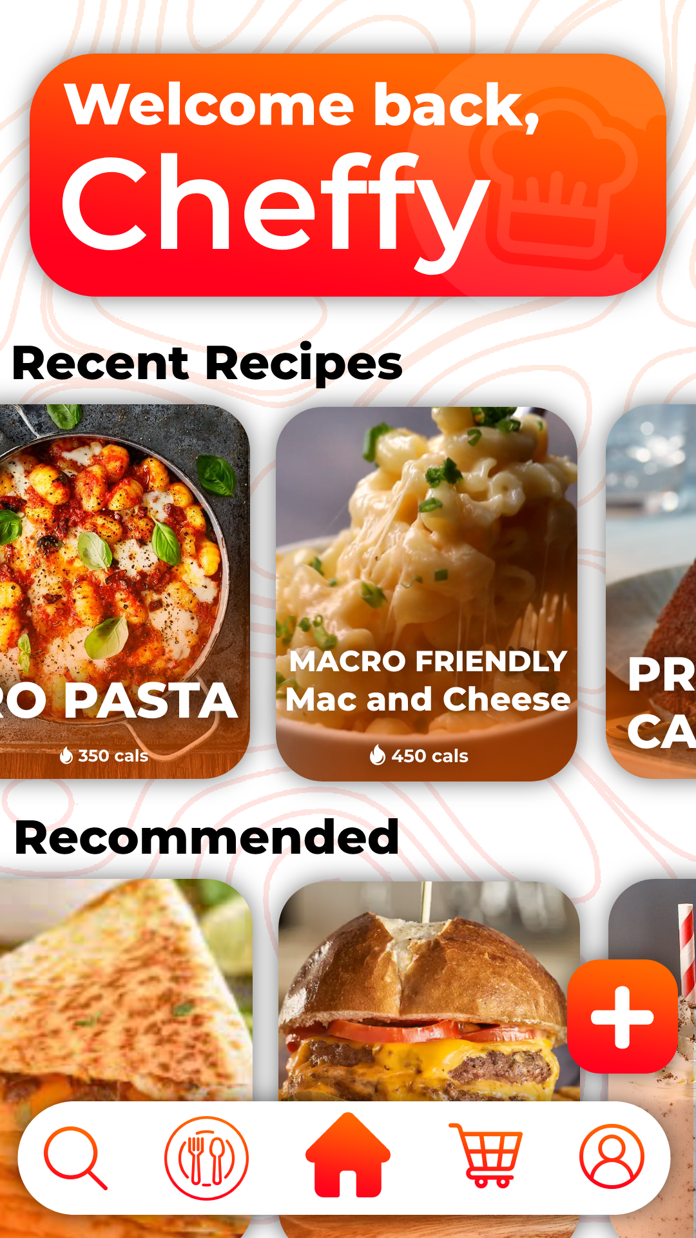




Cheffy
Eat Faster & Smarter With What You Have
Majeedur Rashid & Vitaliy Frankiv
Founders & Ceo
@cheffyapp |

Slide 2




PROBLEM / OPPORTUNITY
An estimated 40% of U.S. college students experience food insecurity, according to Forbes
Seven in 10 adults are motivated to get healthier
Two leading factors why people cannot become healthy is due their lack of money for food and lack of time
80% of your results comes from the food you eat, and only 20% of your results come from your workouts.
Approximately 75 million millennials worldwide use self-help services.
?

Slide 3
VALUE PROPOSITION
Scan and Start SCRANNING
Make DELICIOUS meal recipes which are healthy and fit your macros FROM WHAT YOU HAVE!
Have you been scrolling through Social Media and seen a recipe you like but you want to see if you can make it. You can get the recipes INSTANTLY!
We also make easy meals from food that you have at home so you don’t have to spend money on unnecessary items
Super Easy to Use!

Slide 4
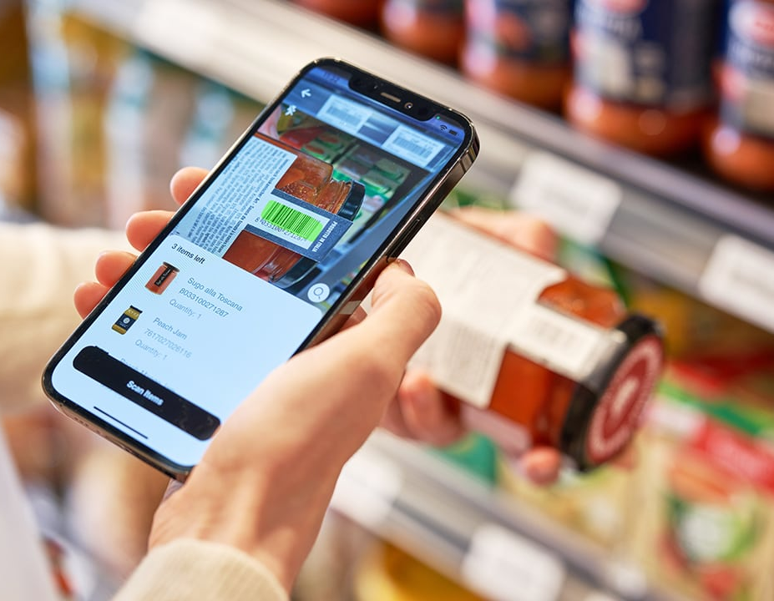
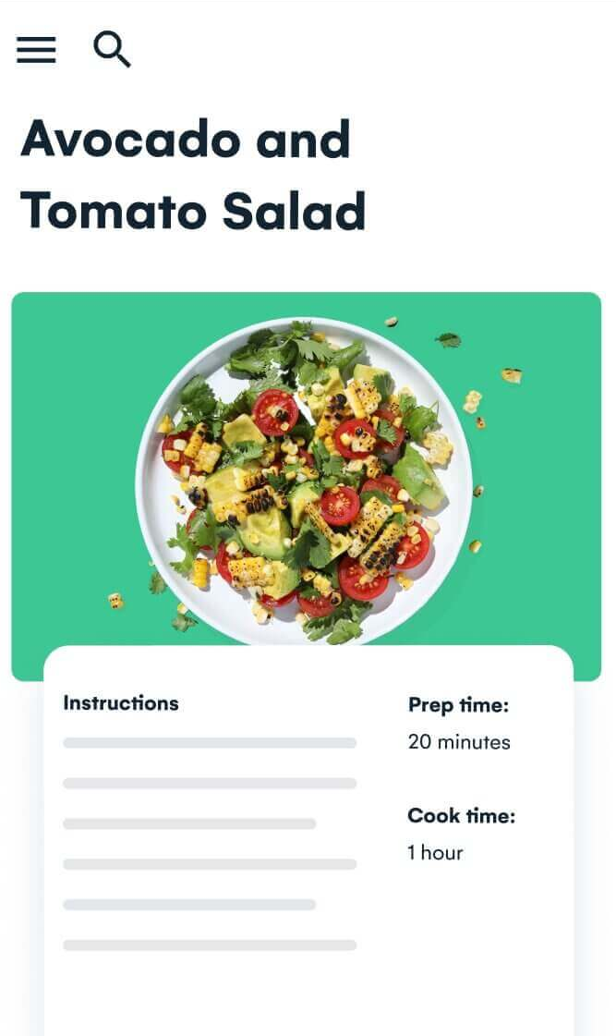

UNDERLYING MAGIC
1
Scan your fridge
Or Manually write items
1
2
2
Instantly Get Recipes with food you already have and with the MACROS!
START COOKIN!
Follow the SUPER EASY recipe and start making some amazing food
3
3

Slide 5

Markets
Food | Self-improvement
Health | Apps
TARGET MARKET
AGE GROUP
\15+ to Younger Adults/ Millennials
Interests
Gender
Trying to take Health more serious
Trying to learn how to cook (beginner chefs)
Goes to the Gym regularly
Uses Social Media
Trying to be better
Spends money on self-care
This app caters to both men and women
Income
Market: $13.2 billion
$55,000+
Approximately 75 million millennials worldwide use self-help services.
According to one survey, 94% of millennials reported making personal improvement commitments and said they'd be willing to spend nearly $300 a month on self-improvement. (Forbes)
Region
International, but mostly U.S users

Slide 6
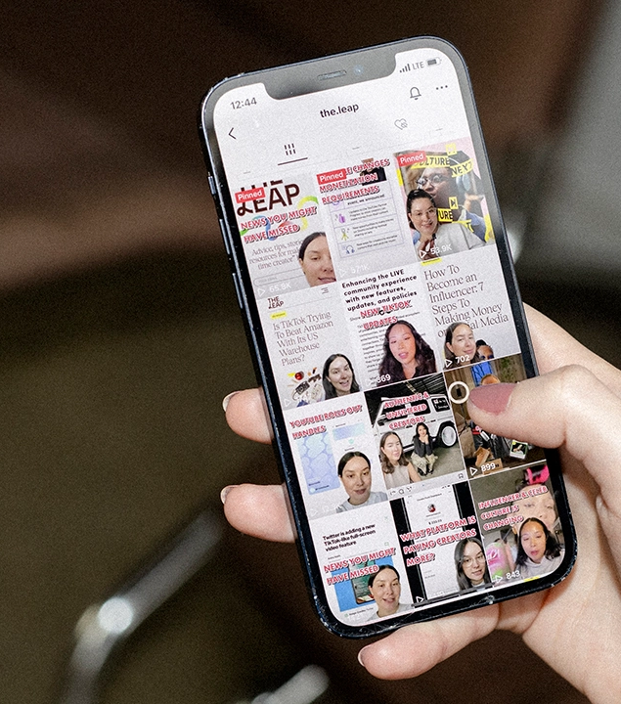





MARKETING PLAN
Promote our app on social media such as Instagram Reels, TikTok, Youtube and etc
Collab with major fitness content creators
Offer deals in certain times of the year (especially in January)
15% OFF
USE CODE
“NEW YEARS”
Ad 0:30

Slide 7

 | Cheffy | Cooklist
 | Freemium $9.99 Monthly (Occasional Deals) | Freemium $5.99 Monthly | Freemium $9.99 monthly /$49.99 yearly
 | - Recipes you get from what you have - Tracks your calories - Connected with social media - Shopping for food by seeing competitors | - Recipes you get from what you have - Shopping for food by seeing competitors | - Tracks your calories - Scan food/track food to see what you ate and drank
 | - Full Customization of Recipes and your preferences | - Although the app offers a wide variety of recipes, users might find that there is not much room for customization or adaptation to personal preferences. | - Customizable goals and tracking, however no food recipes or food customization
MyFitnessPal
Price
Features
COMPETITIVE ANALYSIS
Customization
Competitive advantages
Button on Social Media Apps where you click and the whole recipe is copied on to the app | We have a community on the app; You can post on the app | You can filter what kind of recipes you want

Slide 8

QUALIFICATIONS
Both of us go to the gym and know what it takes to become more healthy
We have taken a computer science course Freshman year and plan to take more computer science classes in the future
We have experienced food insecurity and know how to it feels to not have much
Both of us use social media and know our demographic wants and needs
Both us have worked in groups ranging from small to big and different types of people, we have been able to work well with whoever and be able to take charge

Slide 9
COST STRUCTURE
Definition of One Unit
A Premium Membership
Description of Expenses
Variable Material Expenses | Total: $ 0.00*
N/A | $0.00
*30% commission | per purchase
Fixed Expenses | Total: $665
Insurance | $50
Salary | $500
Advertising | $100
Depreciation | $15
Economics of One Unit
Selling Price
$9.99
$0.00
Cost Of Variable materials
Cost of Labor
App Store Commision
$0.00
$2.99
Total COGS/COSS
$2.99
Contribution margin
$7.00
Monthly Break Even Units
$665 = 95 ≈ 95 units $7.00

Slide 10
CURRENT STATUS & FUTURE PLANS
Plans For
Plans For
Projection
Growth
Philanthropy
Year 1
$6,642.7
Collaborate With A lot of Content Creators
Turn Cheffy into a household name
Create Content around Cheffy
Get more content creators on our App and community
New Free and Premium Features on the app
Make it possible for creators on the app to generate money
Give Free money and food to people in need
We will help structure people's lives and help them get a job and food constantly. And educate them on budgeting and savings. It will be completely free for the people in need.
Partner with foundations that help people with food insecurity
Year 2
$9,782.5
Year 3
Expand Revenue Sources

Slide 11
Cheffy
Eat Faster & Smarter With What You Have
Majeedur Rashid & Vitaliy Frankiv
Founders & Ceo
@cheffyapp |

